Slide 1

BI Project | Analyzing and Visualizing Data with Tableau
By Josh Ho

Slide 2
Table of Contents
About the Dataset
Working with the Dataset
Data Insights
Demographics
Teams
Players
Challenges
Future Goals
Conclusion

Slide 3

INTRODUCING THE DATASET

Slide 4


About the Dataset
FIFA 18 is an installment in the FIFA video game franchise, a series of football simulation games released for several video game consoles
FIFA (Fédération Internationale de Football Association) is the international football association that hosts the World Cup and acts as the sport’s global governing body

Slide 5
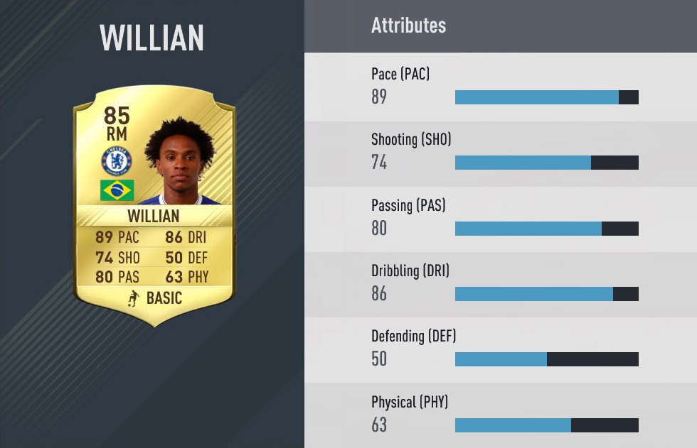
About the Dataset Cont’d
The dataset was found on Kaggle and contains every player and team featured in FIFA 18, with several key datapoints like:
Player attributes (agility, aggression, dribbling, finishing, goalkeeping)
Personal data (age, nationality)
Team info (club name, team size)
And more… (wage, overall rating, potential)

Slide 6
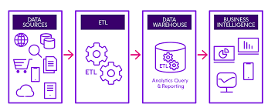
Working with the Dataset
Project Workflow
Started with extracting and transforming the dataset
Then connected and loaded the cleaned dataset into Tableau
Developed insightful questions to retrieve from dataset
Created meaningful data visualizations to answer questions, with the data viz’s acting as visual support and justification
Compiled worksheets and dashboards made to tell a story about the data, and what discoveries were made

Slide 7

Data Insights
DEMOGRAPHICS

Slide 8
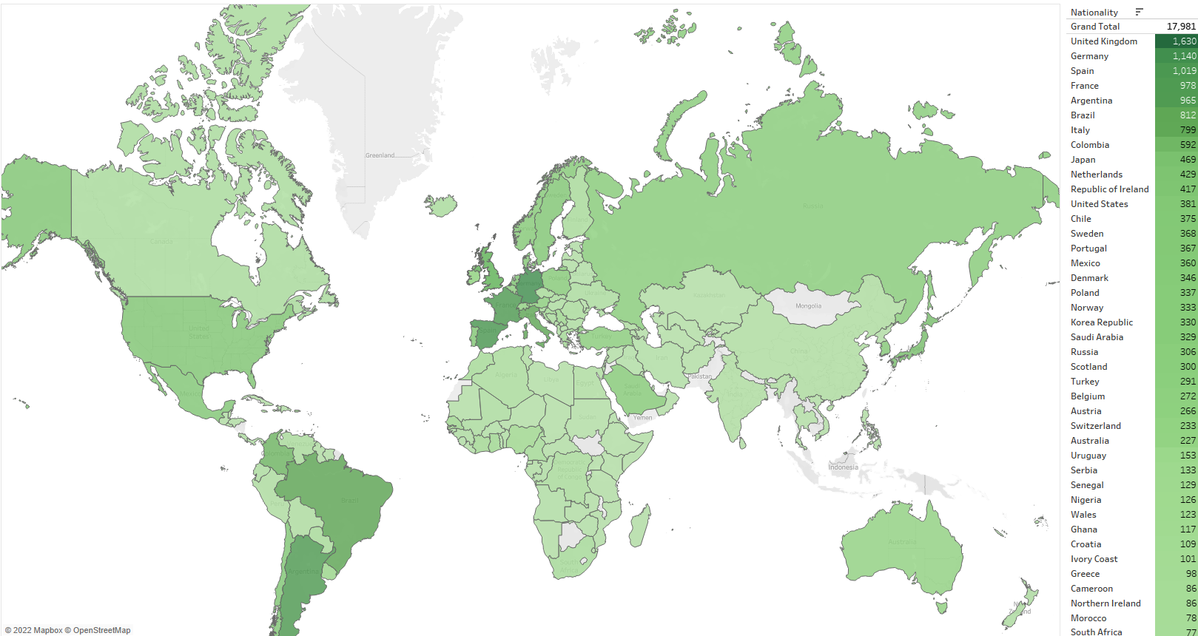
Number of Players by Country
Notes:
Shows the number of players in FIFA 18 and their respective nationalities. With UK, Germany, Spain, France, and Argentina have the top 5 most amount of recorded professionals.

Slide 9
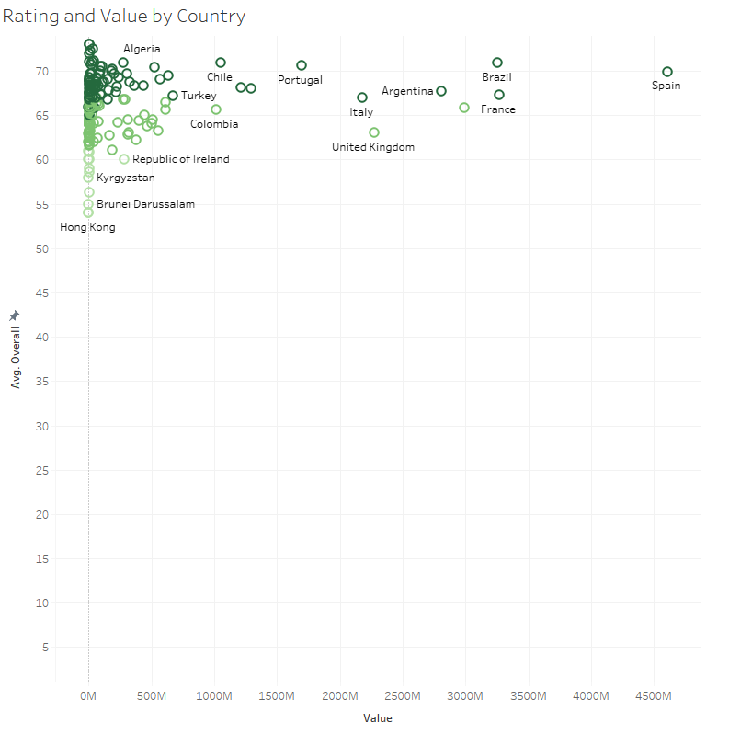
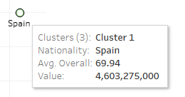
Ratings/Value by Country
Spain, on average, produced some of the best players (based on player rating), whom also received some of the largest contracts (value)
This is just an average, as talented players can be outliers and come from countries not known for producing highly rated players
Notes:
Shows average overall rating of all players by their respective countries, as well the sum value they produced.

Slide 10

Data Insights
TEAMS

Slide 11
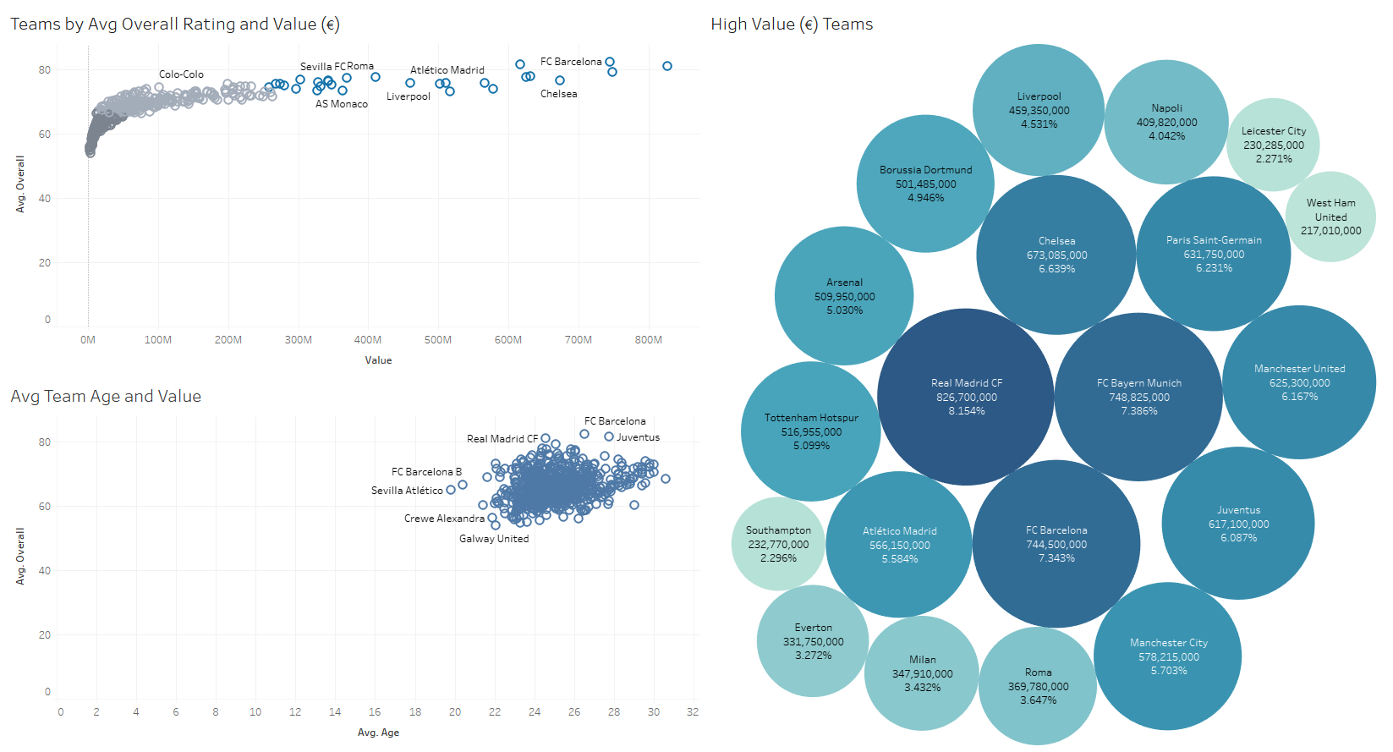
At a Glance

Slide 12
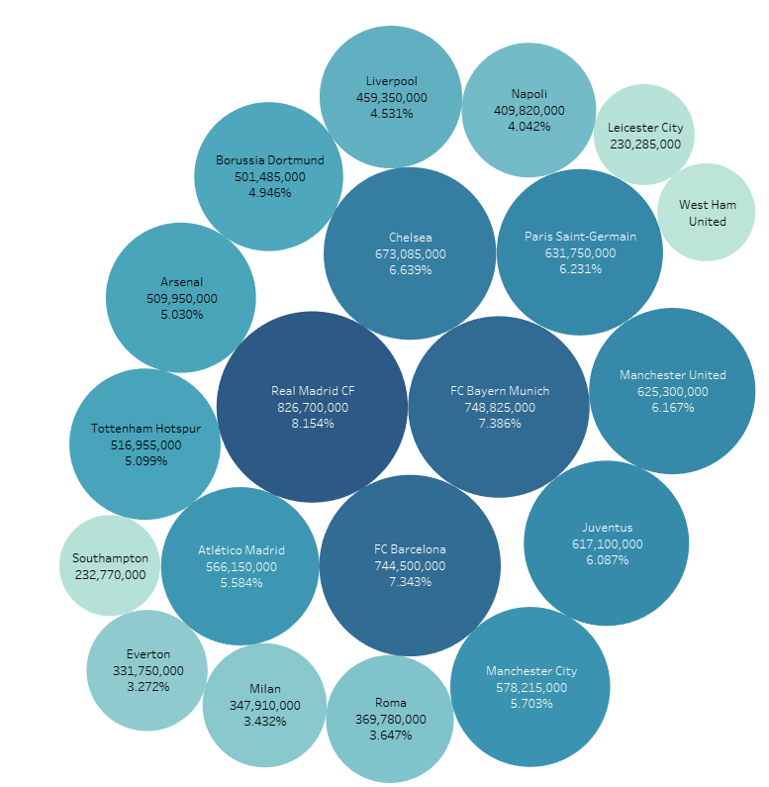
Team Total Value
Real Madrid makes up 8% of the top 20 most valuable clubs by player value
Worth a staggering €826,700,000
Does an expensive team mean a better team?
Notes:
Shows the sum value, and percent of total for the top 20 most valuable teams.

Slide 13
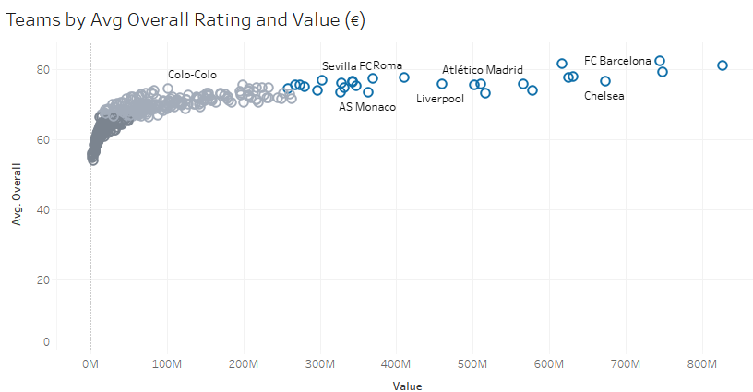
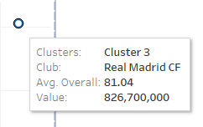
Overall Rating/Value by Team
Mentioned previously, Real Madrid CF is the most valuable club
But they also have the highest average overall rating of 81, meaning their team has some of the highest rated and most talented players
So yes, an expensive team technically can mean a better team, if the definition of better is a higher rating
Notes:
Shows teams by their overall rating (average of all player ratings in each team) and their total values (sum of all player values in each team).

Slide 14


Data Insights
PLAYERS

Slide 15
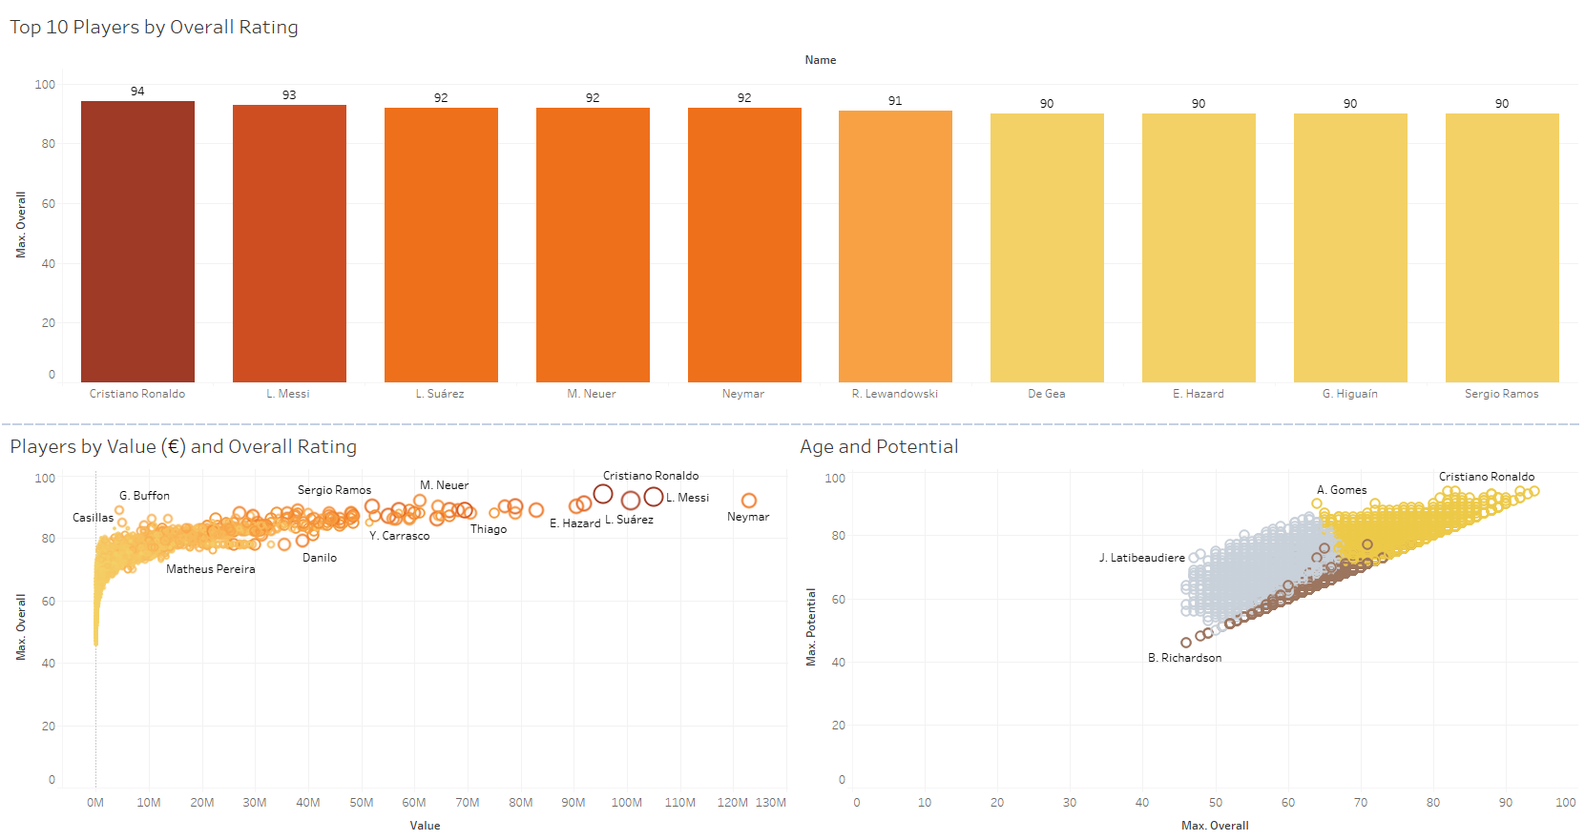
At a Glance

Slide 16
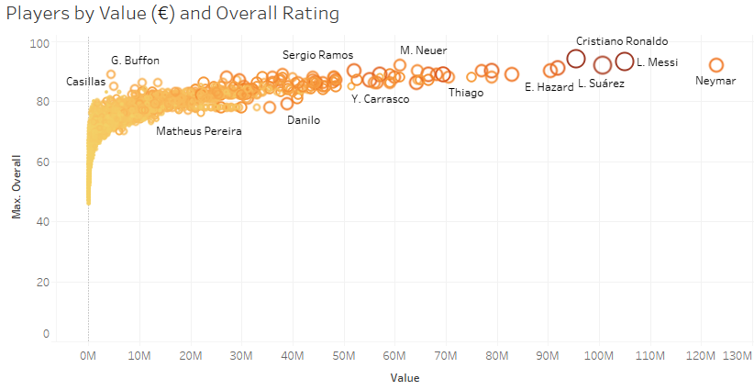
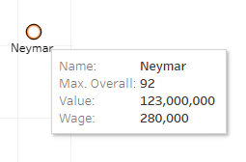
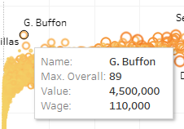
Players by Value/Overall Rating
The higher the players rating, the more likely they are to be given a higher value, especially as teams will shell out money to try and trade for the most talented
Some players have very high ratings but are valued less, meaning some teams may be getting very good deals on certain players
Notes:
Shows players by value and overall rating, with the very best being far ahead of the rest of the players.

Slide 17
Spread of Players by Rating
Tier | Number of Players | Percent of Total
S-Tier (90+) | 11 | 0.06%
A-Tier (80-89) | 508 | 2.83%
B-Tier (70-79) | 5238 | 29.13%
C-Tier (>69) | 12224 | 67.98%
Notes:
Used Python to calculate the spread of players by tier. This shows that a very small percent of players dominate and are the most valuable and skilled players.

Slide 18
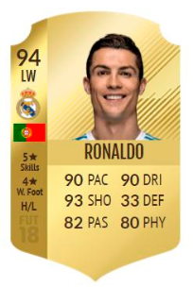


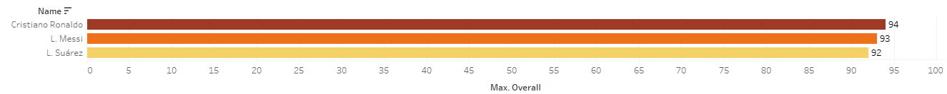
Top 3 Players by Rating
1
3
2
Value: €95,500,000
Value: €100,700,000
Value: €105,000,000
Notes:
Shows the top 3 highest rated overall players.

Slide 19
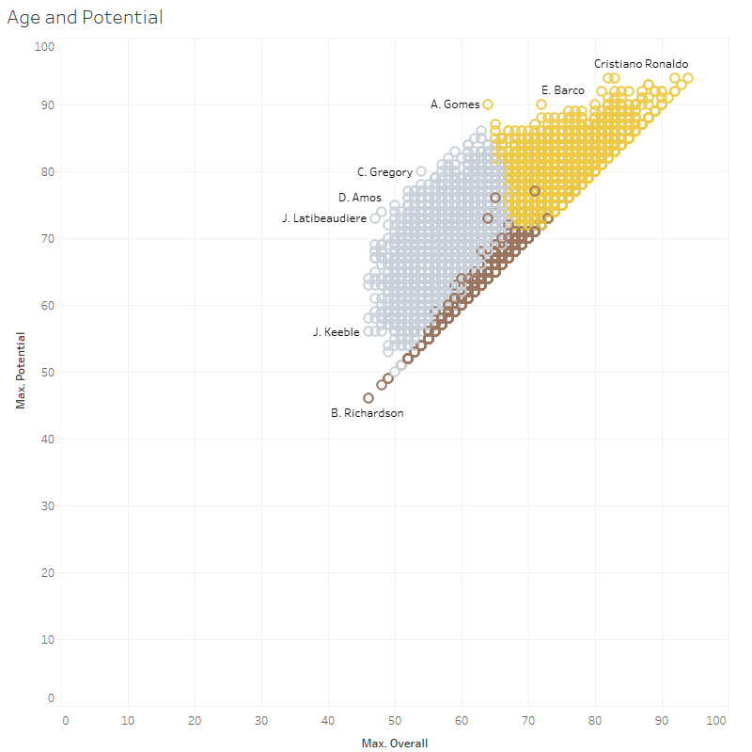

Players by Age and Potential
Used clustering to help group and identify groups of players by their age, rating, and potential
There are many young players who have not yet reached their prime, meaning some of them will vastly improve their overall rating as they age
Which player has the highest overall potential? Who will be the next star?
Notes:
Shows player ages, their current overall rating, and their potential rating.

Slide 20
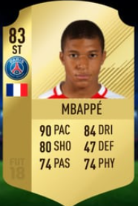


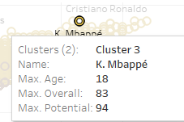
Top Player by Potential Kylian Mbappe
FIFA 18 Potential Rating
FIFA 22 Overall Rating
Value: €190,000,000
“£547m over the next three years in total compensation”
-DailyMail UK
Notes:
Shows the player with the highest rated potential, with a comparison of his rating in FIFA 18 vs FIFA 22.

Slide 21

Challenges
Notes:
The largest challenge was choosing which visualizations to keep for my presentation, and which to simply leave out or remove. There were many exciting and unique visualizations that I created based on prompts and questions about the I came up with. However, this was definitely the hardest part, with only a limited amount of time to present, and prioritizing my most pressing questions, I had to decide which to use and which not to.

Slide 22

Future Goals
Notes:
If I had more time, I would try to increase the quality of visual aids in my PowerPoint presentation, adding even more different aspects of design to compliment my slides. This could be using custom graphics, potential animations, unique icons, and relevant images to enhance the flow and aesthetic of my presentation.

Slide 23

Conclusion
Thank you for listening!
Notes:
Overall, this was a very enjoyable project. I felt I was able to effectively apply the concepts and fundamentals learned regarding data analytics and business intelligence.

